Slide 1

课时练习
期末复习一 模块七 第一章

Slide 2
一、 词汇。
(A)根据语境、音标或所给单词的提示完成句子，每空一词。
1. We sell bikes to a large number of ________ (Africa) countries.
2. The father is so proud of his children and ________ /blaɪnd/ to their wrongs.
3. 2022 can be a year to rebuild, rather than ________ /rɪ'ɡret/.
African
blind
regret

Slide 3
一、 词汇。
(A)根据语境、音标或所给单词的提示完成句子，每空一词。
4. As long as we work hard, the Chinese Dream is sure to come ________ one day.
5. For further information on the trip, write to us at this _________ /ə'dres/.
true
address

Slide 4
一、 词汇。
(B)用括号内所给单词的适当形式填空，每空不限词数。
1. The caste system(种姓制度) shapes many parts of _______ (India) life.
2. My uncle invited his friends _______ (visit) his farm.
3. Tom feels sad because he doesn’t have much _______ (succeed) in finding a job.
Indian
to visit
success

Slide 5
一、 词汇。
(B)用括号内所给单词的适当形式填空，每空不限词数。
4. Greece was the cradle(发源地) of ________ (west) culture.
5. _________ (Russia) culture places a high value(重视) on the homeland and on family.
western
Russian

Slide 6
二、 重点句型。
1. 我将上网跟他联系，获得更多关于他的信息。
I’ll _______________ him on the Internet ______
_________________________________________.
2. 让我们尽最大努力使之成功。
Let’s ____________________________________.
3. 我猜想我们会准备很多美食。
I imagine (that) we will _____________________
_________________________________________.
get in touch with to get more information about him
try our best to make it success
prepare a lot of/lots of delicious food(s)

Slide 7
二、 重点句型。
4. 而且，我确信炒饭和饺子会很受欢迎。
______________, I’m sure that fried rice and
______________________________________.
5. 让我们使他梦想成真。
Let’s _________________________________.
What’s more dumplings will be popular
make his dream come true

Slide 8
三、重点语法。
★宾语从句 I
(A)根据所学知识，将横线上的内容补充完整。
宾语是动作的支配对象，由名词、代词、名词短语或从句充当。当一个从句充当宾语时，这个从句就被称为 ______ 从句。宾语从句与主句之间用 ______ 词连接。当宾语从句为陈述句时，用连词 ______ 引导，此时that只起连接作用，不充当句子成分，也没有词义，常可 ______。如：We believe we’ll win the basketball game this afternoon.
宾语
连接
that
省略

Slide 9
三、重点语法。
宾语从句的时态：
1. 当主句的谓语动词是 __________ 时态的时候，宾语从句的谓语动词不受主句时态的影响，可根据需要使用恰当的时态。如：I know he will come here soon.
2. 当主句的谓语动词是 __________ 时态的时候，宾语从句的谓语动词通常使用相应的过去时态。如： Mary said her uncle lived in Shanghai.
一般现在
一般过去

Slide 10
三、重点语法。
3. 当宾语从句陈述的是客观真理或客观事实时，宾语从句的时态不受主句时态的影响，宾语从句的谓语动词用 ___________。如：Mr. Green told us the leaves turn yellow in autumn.
一般现在时

Slide 11
三、重点语法。
(B)根据中文提示完成英语句子。(每条横线不限词数。)
1. 我们确信他明天将去钓鱼。
We’re sure _____________________________________.
2. 我知道我妈妈正在洗衣服。
I know ___________________________.
3. 老师告诉我们地球绕着太阳转。
The teacher told us ________________________________.
he is going fishing/will go fishing tomorrow
my mother is washing clothes
the earth goes/travels around the sun

Slide 12
三、重点语法。
(B)根据中文提示完成英语句子。(每条横线不限词数。)
4. 我叔叔说他第二天将飞往伦敦。
My uncle said he ______________________
_____________________________________.
5. 我认为我们最好骑自行车去公园。
I think _______________________________
_____________________________________.
was flying /would fly to London the next day
we’d better go to the park by bike/ ride (a bike) to the park

Slide 13
四、单项选择。
( )1. —I’m going to send some useful information to you. Could you please tell me your email _______?
—Of course. Thank you.
A. number B. address C. date
B

Slide 14
四、单项选择。
( )2. —May I invite you to my birthday party this weekend?
—________ I’d love to.
A. Sorry, I have no time.
B. You are welcome.
C. What a surprise!
C

Slide 15
四、单项选择。
( )3. In the old days, people _______ each other mainly by letter.
A. got in touch with B. prepared for
C. worked for
A

Slide 16
四、单项选择。
( )4. My father works very hard every day _______ create(创造) a better life for our family.
A. in order B. in order to C. so that
B

Slide 17
四、单项选择。
( )5. —Can you _______ what life will be like in 50 years?
—I guess people may live on the moon.
A. imagine B. notice C. discuss
A

Slide 18
四、单项选择。
( )6. That’s a great movie. Kate _______ she can’t go to see it with her friends this evening.
A. wonders B. hopes C. regrets
C

Slide 19
四、单项选择。
( )7. The man is always selfish(自私的), so he could _______ no one when he’s in trouble.
A. look after B. turn to C. worry about
B

Slide 20
四、单项选择。
( )8. Huawei tries its best to leave no one behind in the digital world(数字世界) and make millions of dreams ________.
A. come true B. come on C. come out
A

Slide 21
四、单项选择。
( )9. —I’m sorry I can’t help you.
—________. Thank you all the same.
A. Never mind B. That’s right
C. It’s a pleasure
A

Slide 22
四、单项选择。
( )10. By making buildings white, cities may _______ the warming process(气候变暖的步伐).
A. slow down B. put down C. deal with
A

Slide 23
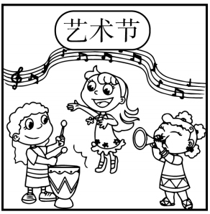
五、看图写话。
1. be, prepare for
The girls/They are preparing for the art festival.

Slide 24
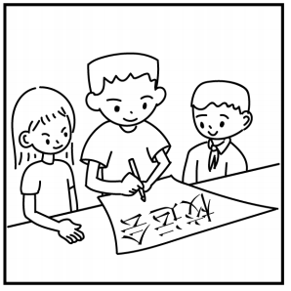
五、看图写话。
2. poster, for, now
The students/They are making a poster for the sports meet now.

Slide 25
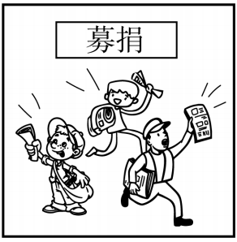
五、看图写话。
3. sell
They sell/are selling newspapers to raise money.

Slide 26
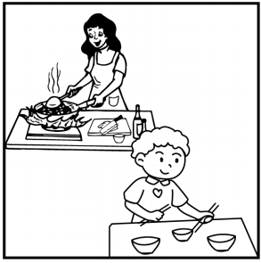
五、看图写话。
4. while
While the boy is/was setting the table, his mother is/was cooking.

Slide 27
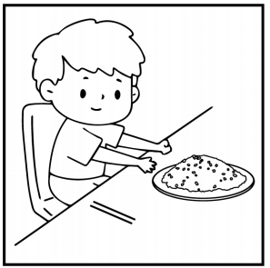
五、看图写话。
5. often, lunch
The boy/He often has fried rice for lunch.

Slide 28
六、短文填空。
Are you going to have dinner 1 your western friend’s home? Then be 2 (care) with your table manners. Good manners will make you a nice guest. You may find western table manners are 3 /kwaɪt/ different from Chinese manners. Here 4 some useful advice to keep you cool.
at/in
careful
quite
is

Slide 29
六、短文填空。
When you are ready to eat, sit up straight(笔直地) on the chair. Usually, you should not put your elbows on the table. The 5 (one) thing you need to do is to pick your napkin(餐巾) up and put it on your lap. You can use it to clean your hands or mouth, 6 not your face. When you 7 /'fɪnɪʃ/ eating, put it back on the table.
first
but
finish

Slide 30
六、短文填空。
Don’t make any 8 (noisy) when you eat or drink the soup. Also, it’s not good to speak when your mouth is 9 ./fʊl/. If you do that, the other people will see the food in your mouth. If you want to get some food but you can’t reach it, just ask 10 (other) to pass the dish to you. Put bones on the edge of the plate. And remember, take bread with your hand, not with a fork.
noise
full
others

Slide 31
七、完形填空。
Robert Lee grew up in New York City. Because his family was not 1 , he learned from a young age that it’s important to cut down on food waste. 2 he was at school, Lee joined a student group to deliver(分发) the leftover(吃剩的) food to people without homes. This experience made him 3 how serious the problem of food waste was.
1. A. poor B. rich C. big
2. A. But B. If C. While
3. A. understand B. agree C. imagine
B
C
A

Slide 32
七、完形填空。
After 4 school, Lee and a friend started an organization(组织) called Rescuing Leftover Cuisine. Its 5 .is to get unsold food from restaurants and deliver it to people who need food. Volunteers(志愿者) pick up food from restaurants around the city and give it to 6 .in need.
4. A. visiting B. leaving C. starting
5. A. purpose B. decision C. direction
6. A. that B. those C. these
B
A
B

Slide 33
七、完形填空。
Lee and his team also made an app 7 the organization. Restaurants use it to give Lee’s team the information about how much leftover food they have each day. Then volunteers get the food and give it out. Lee’s organization is a big 8 . now. He and his team have delivered over 150,000 kilos of food, 9 almost 300,000 meals to people in need.
7. A. for B. to C. out
8. A. dream B. pity C. success
9. A. serving B. cooking C. selling
A
C
A

Slide 34
七、完形填空。
Lee just does a little thing but he has really improved the 10 of people around. But Lee says that his work isn’t over yet. “It’s just the beginning. The need is so great that we need to do a lot more,” he said.
10. A. health B. life C. environment
B

Slide 35


